Slide 1
Time Variation in Betting-Against-Beta
Prachi Deuskar (ISB), Nitin Kumar (ISB), and Adarsh Kuthuru (ISB)
Brown Bag, ISB 2018

Slide 2
Outline
Background
Central Idea
Data/Sample
Results
To-do

Slide 3
Background: Betting-Against-Beta
Empirical limitation of CAPM
SML (Expected Returns vs beta) is flatter than implied by CAPM.
How can this be exploited?
Frazzini and Pedersen (2014): betting-against-beta (BAB) factor.
Robust evidence
BAB works in all markets and asset classes.

Slide 4
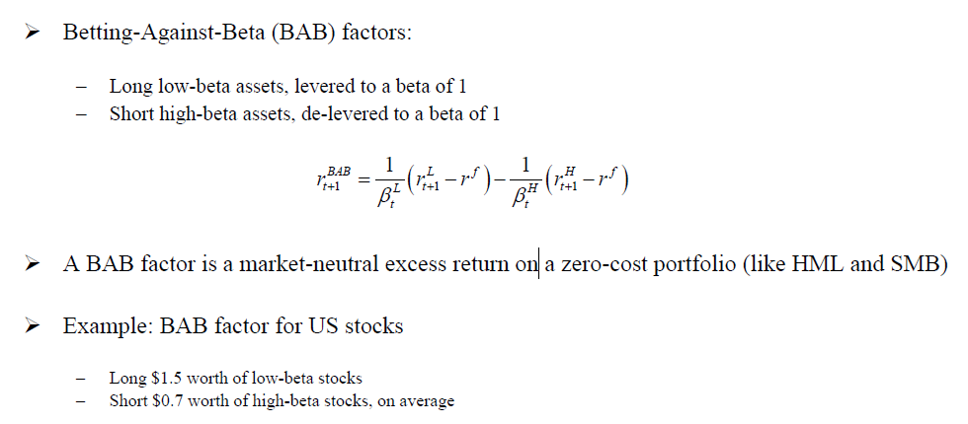
Background: Betting-Against-Beta Construction

Slide 5
Background: Betting-Against-Beta (Explanations)
Leverage constraints
Constrained investors have high demand for high-β stocks.
Preference for lottery stocks
Investors have a “taste” for lottery like stocks. They invest in high volatility stocks.
Benchmarking
Benchmarking induces managers to invest in high-β stocks.

Slide 6
Central Idea
Is there a time-variation in BAB factor returns?
Yes, there is.
Ret(BAB) = f(lagged market return).
What causes this time-variation?
We propose a mechanism.
First study to explicitly link portfolio re-balancing by fund managers to BAB factor premium.
Explaining the time-variation in BAB can shed light on the underlying explanation for BAB premium.

Slide 7
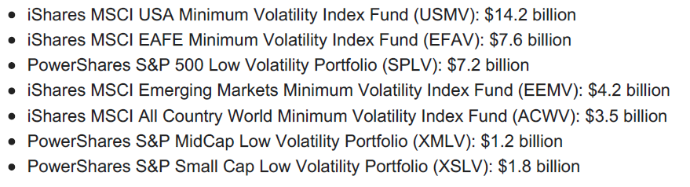
Relevance - Is it worth studying time-variation in BAB?
Academic literature on BAB in recent years
Baker, Bradley and Wurgler (2011), Asness, Frazzini and Pedersen (2012), Frazzini and Pedersen (2014), Asness, Frazzini and Pedersen (2014), Bali et al (2017), Christoffersen and Simutin (2017), Boguth and Simutin (2018).
Industry application
As of Oct 2017, there were 7 ETFs with at least $1 billion in AUMs based on low volatility

Slide 8
Sample – Table 1
 |  |  |  |  |  | Full sample |  |  |  | Large cap sample
Country code | Country | Local market Index | Start_year | End_year |  | #Stocks | Avg MktCap ($B) | Total MktCap ($B) |  | #Stocks | Avg MktCap ($B) | Total MktCap ($B) | % of Full Sample
AUS | AUSTRALIA | MSCI-AUSTRALIA | 1985 | 2018 |  | 867 | 0.72 | 680.78 |  | 179 | 2.85 | 560.97 | 0.91
AUT | AUSTRIA | MSCI-AUSTRIA | 1985 | 2018 |  | 31 | 2.36 | 242.55 |  | 15 | 5.84 | 238.04 | 0.82
BEL | BELGIUM | MSCI-BELGIUM | 1985 | 2018 |  | 75 | 2.03 | 269.52 |  | 23 | 6.09 | 246.71 | 0.85
BRA | BRAZIL | MSCI-BRAZIL | 1985 | 2018 |  | 111 | 5.01 | 1194.97 |  | 31 | 15.40 | 995.84 | 0.94
CAN | CANADA | MSCI-CANADA | 1984 | 2018 |  | 897 | 0.98 | 989.24 |  | 389 | 3.56 | 783.52 | 0.92
CHE | SWITZERLAND | MSCI-SWITZERLAND | 1985 | 2018 |  | 113 | 4.37 | 637.68 |  | 25 | 12.14 | 550.09 | 0.92
CHL | CHILE | MSCI-CHILE | 1988 | 2018 |  | 100 | 1.06 | 131.22 |  | 54 | 1.85 | 126.68 | 0.91
DEU | GERMANY | MSCI-GERMANY | 1985 | 2018 |  | 342 | 3.72 | 829.52 |  | 47 | 13.15 | 697.04 | 0.93
DNK | DENMARK | MSCI-DENMARK | 1985 | 2018 |  | 72 | 0.84 | 109.58 |  | 38 | 2.37 | 127.33 | 0.89
ESP | SPAIN | MSCI-SPAIN | 1985 | 2018 |  | 93 | 3.62 | 584.56 |  | 32 | 9.44 | 470.57 | 0.92
FIN | FINLAND | MSCI-FINLAND | 1985 | 2018 |  | 58 | 2.75 | 261.06 |  | 18 | 8.81 | 261.82 | 0.87
FRA | FRANCE | MSCI-FRANCE | 1985 | 2018 |  | 474 | 2.84 | 928.57 |  | 96 | 9.38 | 703.50 | 0.87
GBR | UNITED KINGDOM | MSCI-UNITED KINGDOM | 1985 | 2018 |  | 1190 | 5.18 | 1364.74 |  | 35 | 16.66 | 1132.42 | 0.95
GRC | GREECE | MSCI-GREECE | 1988 | 2018 |  | 170 | 0.74 | 108.00 |  | 78 | 1.85 | 97.08 | 0.88
HKG | HONGKONG | MSCI-HONGKONG | 1985 | 2018 |  | 603 | 1.00 | 634.43 |  | 192 | 2.68 | 550.16 | 0.94
IND | INDIA | MSCI-INDIA | 1988 | 2018 |  | 1257 | 0.60 | 549.84 |  | 308 | 1.51 | 485.98 | 0.94
IRL | IRELAND | MSCI-IRELAND | 1985 | 2018 |  | 37 | 2.75 | 284.37 |  | 19 | 5.93 | 258.29 | 0.94
ISR | ISRAEL | MSCI-ISRAEL | 1994 | 2018 |  | 262 | 0.45 | 98.99 |  | 113 | 0.87 | 94.11 | 0.94
ITA | ITALY | MSCI-ITALY | 1985 | 2018 |  | 159 | 2.48 | 453.28 |  | 67 | 5.61 | 419.83 | 0.93
JPN | JAPAN | MSCI-JAPAN | 1985 | 2018 |  | 1553 | 1.18 | 680.54 |  | 589 | 2.37 | 567.69 | 0.93
MEX | MEXICO | MSCI-MEXICO | 1986 | 2018 |  | 78 | 2.27 | 230.88 |  | 56 | 2.99 | 224.63 | 0.94
MYS | MALAYSIA | MSCI-MALAYSIA | 1985 | 2018 |  | 561 | 0.44 | 238.87 |  | 251 | 0.93 | 226.95 | 0.96
NLD | NETHERLANDS | MSCI-NETHERLANDS | 1985 | 2018 |  | 107 | 5.09 | 742.03 |  | 20 | 15.59 | 733.87 | 0.94
NOR | NORWAY | MSCI-NORWAY | 1985 | 2018 |  | 89 | 1.16 | 135.29 |  | 34 | 2.95 | 128.99 | 0.91
NZL | NEWZEALAND | MSCI-NEWZEALAND | 1985 | 2018 |  | 76 | 0.46 | 45.81 |  | 37 | 0.85 | 43.77 | 0.88
PRT | PORTUGAL | MSCI-PORTUGAL | 1988 | 2018 |  | 39 | 1.16 | 54.01 |  | 18 | 2.11 | 52.20 | 0.87
SGP | SINGAPORE | MSCI-SINGAPORE | 1985 | 2018 |  | 308 | 0.66 | 243.60 |  | 96 | 1.79 | 226.46 | 0.89
SWE | SWEDEN | MSCI-SWEDEN | 1985 | 2018 |  | 182 | 1.25 | 265.56 |  | 45 | 2.95 | 253.33 | 0.93
THA | THAILAND | MSCI-THAILAND | 1986 | 2018 |  | 261 | 0.50 | 208.08 |  | 122 | 0.98 | 203.35 | 0.95
TWN | TAIWAN | MSCI-TAIWAN | 1988 | 2018 |  | 912 | 0.62 | 472.54 |  | 449 | 1.16 | 439.49 | 0.92
ZAF | SOUTHAFRICA | MSCI-SOUTHAFRICA | 1985 | 2018 |  | 206 | 2.19 | 512.74 |  | 87 | 5.17 | 427.18 | 0.86
USA | UNITED STATES | CRSP-VW INDEX | 1928 | 2018 |  | 2784 | 1.44 | 3883.85 |  | 1871 | 2.37 | 3328.75 | 0.87

Slide 9
Results – Table 2, FP 2014 replication
Portfolio | 1(Low Beta) | 2 | 3 | 4 | 5 | 6 | 7 | 8 | 9 | 10(High Beta) | BAB Portfolio
Excess returns | 1.282 | 1.279 | 1.331 | 1.295 | 1.377 | 1.403 | 1.390 | 1.469 | 1.353 | 1.346 | 0.756
 | (9.659) | (8.056) | (7.265) | (6.699) | (6.308) | (5.899) | (5.443) | (5.339) | (4.404) | (3.608) | (7.657)
CAPM Alpha | 0.646 | 0.562 | 0.508 | 0.487 | 0.392 | 0.334 | 0.290 | 0.247 | 0.060 | -0.265 | 0.993
 | (6.658) | (5.694) | (4.935) | (4.658) | (3.698) | (2.839) | (2.323) | (1.744) | (0.366) | (-1.079) | (7.648)
Three Factor Alpha | 0.439 | 0.339 | 0.277 | 0.243 | 0.154 | 0.078 | 0.025 | -0.031 | -0.209 | -0.581 | 0.827
 | (6.138) | (5.084) | (4.463) | (3.972) | (2.594) | (1.192) | (0.367) | (-0.370) | (-2.061) | (-3.236) | (6.601)
Four Factor Alpha | 0.461 | 0.366 | 0.317 | 0.296 | 0.205 | 0.183 | 0.151 | 0.157 | 0.040 | -0.113 | 0.626
 | (6.318) | (5.386) | (5.023) | (4.806) | (3.424) | (2.859) | (2.294) | (2.049) | (0.428) | (-0.702) | (5.114)
Five Factor Alpha | 0.406 | 0.250 | 0.207 | 0.180 | 0.094 | 0.066 | 0.032 | 0.010 | -0.088 | -0.223 | 0.552
 | (5.587) | (3.860) | (3.427) | (3.082) | (1.652) | (1.042) | (0.485) | (0.122) | (-0.884) | (-1.284) | (4.638)
Beta (Ex ante) | 0.619 | 0.793 | 0.887 | 0.971 | 1.050 | 1.129 | 1.214 | 1.317 | 1.457 | 1.784 | 0.000
Beta (realized) | 0.623 | 0.826 | 0.949 | 1.027 | 1.097 | 1.166 | 1.272 | 1.371 | 1.482 | 1.772 | -0.056
Volatility | 4.346 | 5.199 | 6.002 | 6.330 | 7.153 | 7.791 | 8.363 | 9.014 | 10.062 | 12.218 | 3.233
Sharpe Ratio | 0.802 | 0.668 | 0.609 | 0.558 | 0.534 | 0.501 | 0.461 | 0.459 | 0.371 | 0.303 | 0.810

Slide 10
Conditional BAB strategy
Conditional BAB
Invest in BAB if lagged market return > 0
Invest in risk-free asset if lagged market return < 0
Why this strategy?
Motivated from mutual fund risk-taking literature

Slide 11
Results – Table 3, Conditional BAB
 | Full sample
Country | Avg BAB return (Following Mkt ret < 0) | Avg ret of the rest (Following Mkt ret >= 0) | Difference in returns(B-C) | tstat | pvalue
AUSTRALIA | 0.377 | 2.361 | 1.984 | 3.950 | 0.000
AUSTRIA | 0.659 | 1.108 | 0.449 | 0.640 | 0.523
BELGIUM | 0.477 | 0.798 | 0.322 | 0.910 | 0.362
CANADA | 0.457 | 2.431 | 1.974 | 3.360 | 0.001
SWITZERLAND | 0.752 | 0.722 | -0.030 | 0.540 | 0.587
GERMANY | 0.344 | 1.181 | 0.837 | 1.370 | 0.173
DENMARK | 0.217 | 1.061 | 0.844 | 1.690 | 0.091
SPAIN | -0.152 | 1.163 | 1.315 | 2.560 | 0.011
FINLAND | 0.360 | 1.764 | 1.404 | 1.550 | 0.122
FRANCE | 0.376 | 1.837 | 1.461 | 2.570 | 0.011
UNITED KINGDOM | -1.227 | 1.765 | 2.992 | 6.250 | 0.000
GREECE | -0.239 | 1.708 | 1.947 | 1.720 | 0.087
HONGKONG | -0.441 | 3.056 | 3.497 | 5.300 | 0.000
IRELAND | -1.064 | 2.244 | 3.308 | 2.400 | 0.017
ISRAEL | -0.464 | 2.409 | 2.874 | 5.010 | 0.000
ITALY | -0.199 | 1.442 | 1.641 | 3.800 | 0.000
JAPAN | -0.563 | 1.120 | 1.684 | 3.680 | 0.000
NETHERLANDS | 0.479 | 1.263 | 0.785 | 0.730 | 0.467
NORWAY | 0.420 | 1.483 | 1.062 | 1.790 | 0.074
NEWZEALAND | 0.485 | 1.821 | 1.336 | 2.000 | 0.046
PORTUGAL | 0.481 | 1.880 | 1.399 | 0.490 | 0.627
SINGAPORE | 0.324 | 1.761 | 1.437 | 3.210 | 0.001
SWEDEN | 0.928 | 1.330 | 0.403 | 0.230 | 0.820
UNITED STATES | -0.019 | 1.068 | 1.087 | 5.240 | 0.000

Slide 12
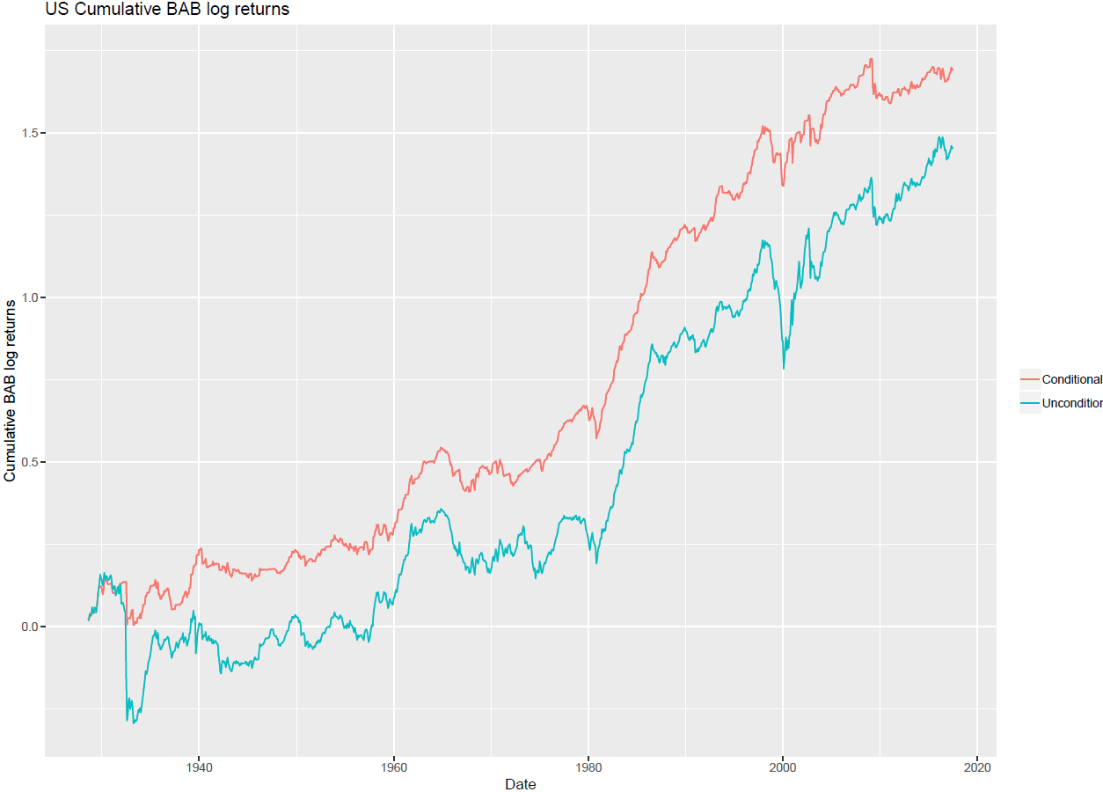
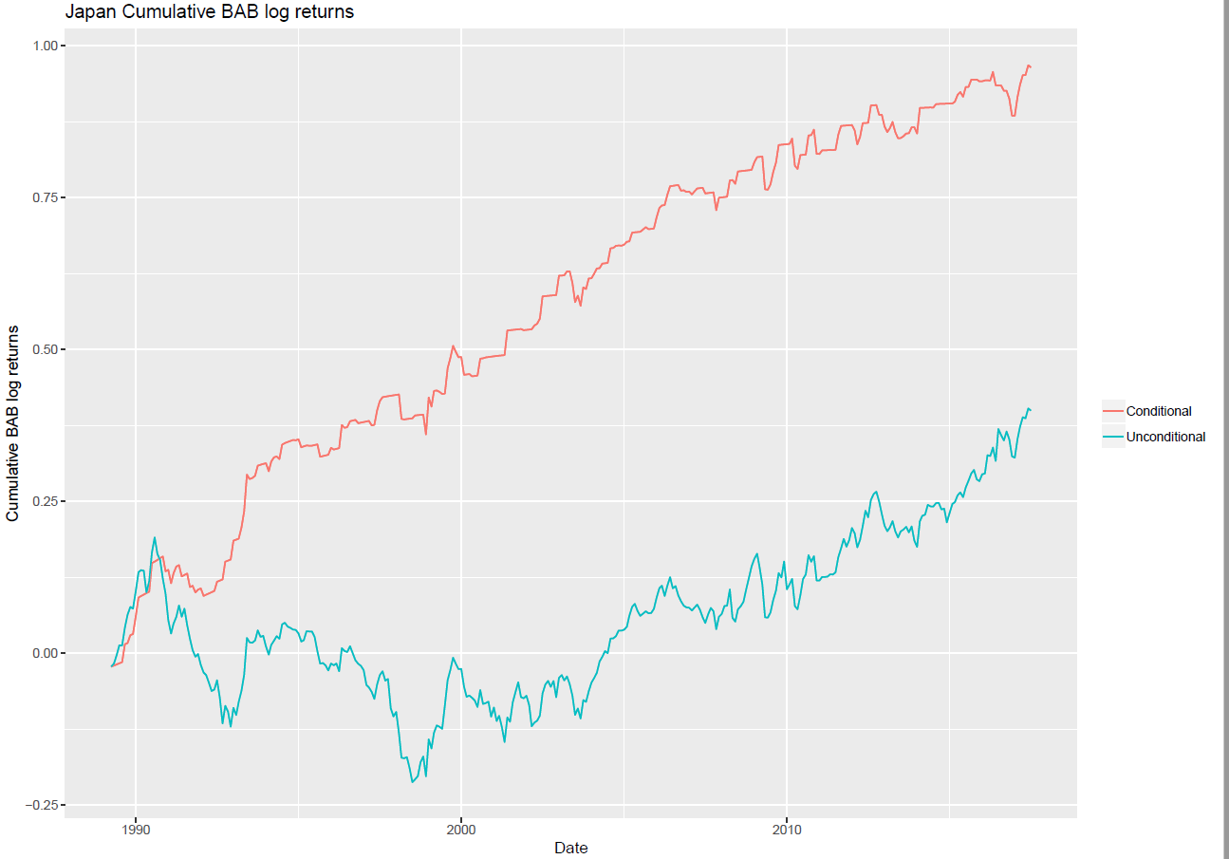
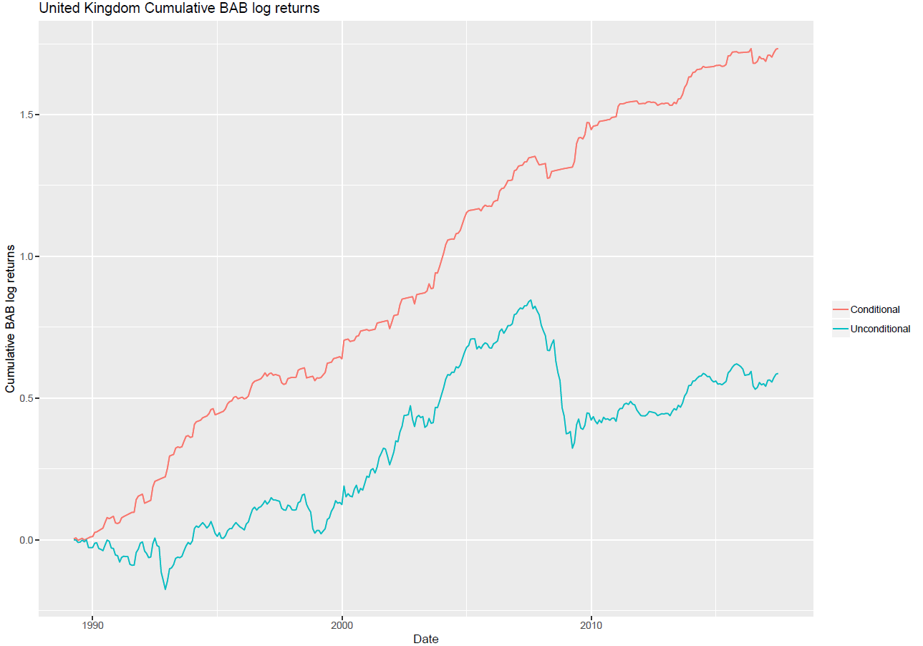
Results – Cumulative returns in various markets

Slide 13
Results – Table 4, performance statistics, US
 | Large Cap |  |  | Full Sample
 | BAB | Cond BAB |  | BAB | Cond BAB
Ret | 0.39 | 0.40 |  | 0.76 | 0.85
Tstat | (3.38) | (4.80) |  | (7.66) | (11.29)
Vol | 3.74 | 2.75 |  | 3.23 | 2.45
Vol (downside) | 2.55 | 1.85 |  | 1.99 | 1.34
Skewness | -1.85 | -1.55 |  | -0.82 | 0.12
1 percentile | -10.45 | -8.88 |  | -8.73 | -6.72
Min Ret | -36.66 | -25.91 |  | -25.19 | -16.06
Sharpe ratio | 0.36 | 0.51 |  | 0.81 | 1.20
Sortino ratio | 0.52 | 0.76 |  | 1.32 | 2.19

Slide 14
Results – Table 5, alphas, US
 | Large Cap |  |  | Full Sample
 | BAB | Cond BAB |  | BAB | Cond BAB
CAPM Alpha | 0.56 | 0.53 |  | 0.99 | 1.10
 | (4.06) | (4.83) |  | (7.65) | (11.03)
Three Factor Alpha | 0.41 | 0.45 |  | 0.83 | 1.02
 | (3.12) | (4.17) |  | (6.60) | (10.25)
Four Factor Alpha | 0.22 | 0.28 |  | 0.63 | 0.87
 | (1.67) | (2.68) |  | (5.11) | (8.89)
Five Factor Alpha | 0.12 | 0.29 |  | 0.55 | 0.88
 | (0.94) | (2.69) |  | (4.64) | (8.83)

Slide 15
To-do list
So far, we have established time-variation in BAB.
To-do: analyze international markets for large-cap only.
But what causes this time-variation?
Hypothesis: long-only funds buy high-β stocks following negative market returns, as these funds also earn negative return.
Link portfolio re-balancing to time-variation in BAB.
Other to-do
Alternative explanations: time-variation in leverage constraints and lottery demand
Cross-sectional implications
Funds with high AUM should impact greater variation in BAB
Is it linked to manager tenure?
Business cycle related variation
Do we observe similar behavior in recessions and expansions?

Slide 16
Thank you

